Slide 1
Early Cardiovascular Disease Detection
Using Machine Learning and Explainable AI
Bhargava Dandu
M.Sc. Data Analytics
Supervisor: Dr. Zohaib Ijaz.

Slide 2
Problem Definition
High accuracy ML/DL models exist but lack interpretability.
In healthcare, transparency is vital for clinical trust.
Challenges: • Need to explain model predictions (reduce black-box effect). • Improve reliability of heart disease detection models.
Research Objectives: • Using feature engineering techniques to create new features to enhance predictive performance. • Apply SHAP and LIME to interpret model behavior.

Slide 3
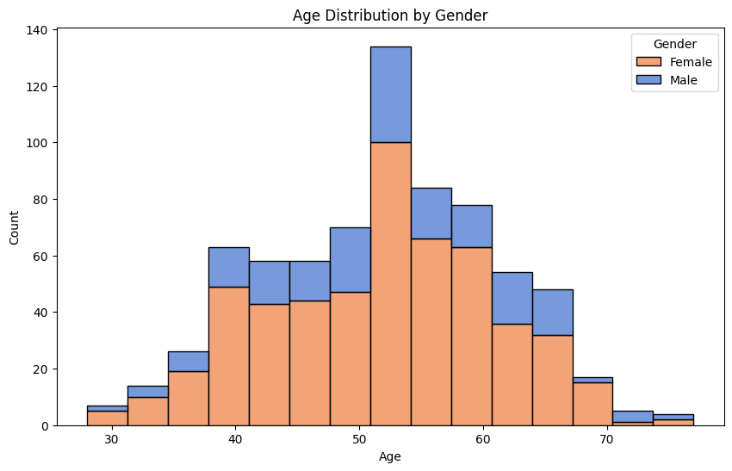
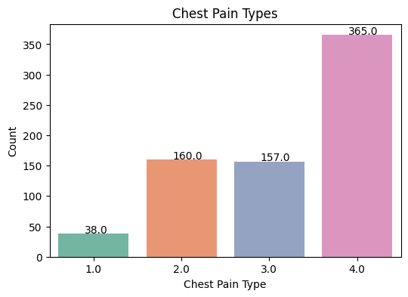
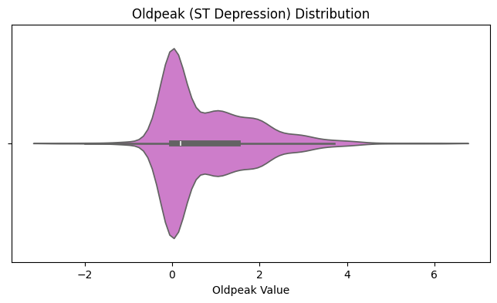
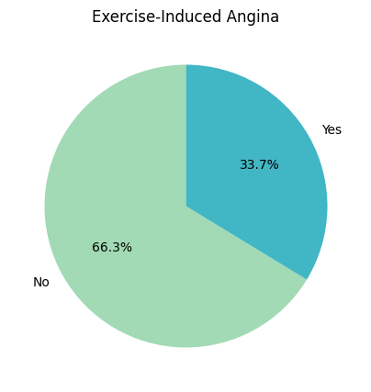
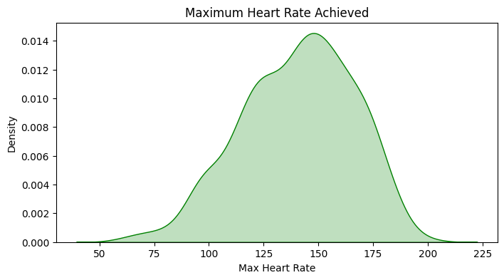
Dataset Distributions

Slide 4
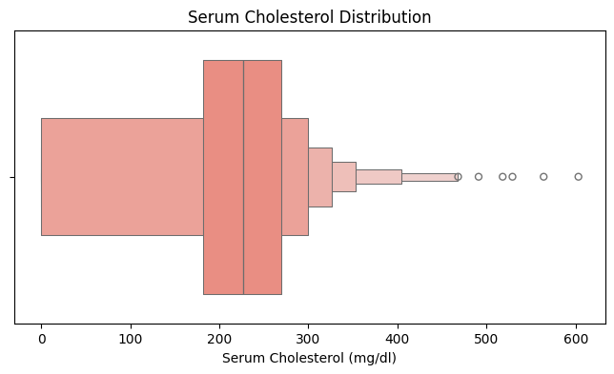
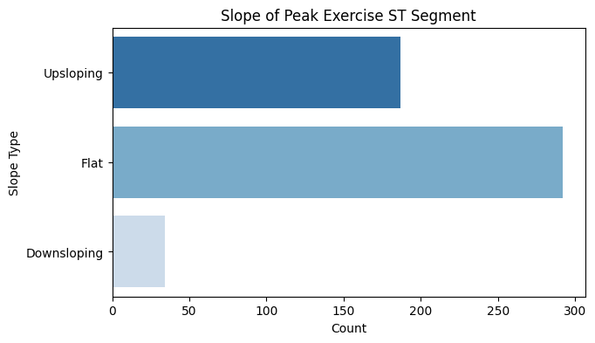
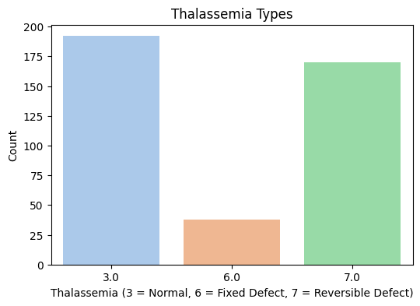
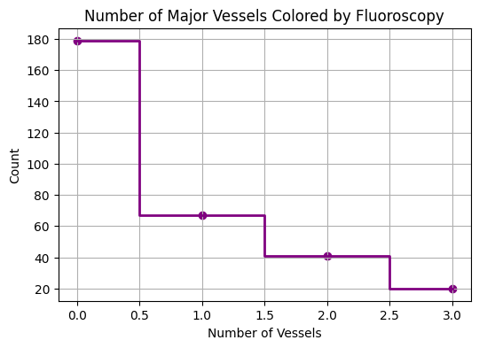
Dataset Distributions

Slide 5
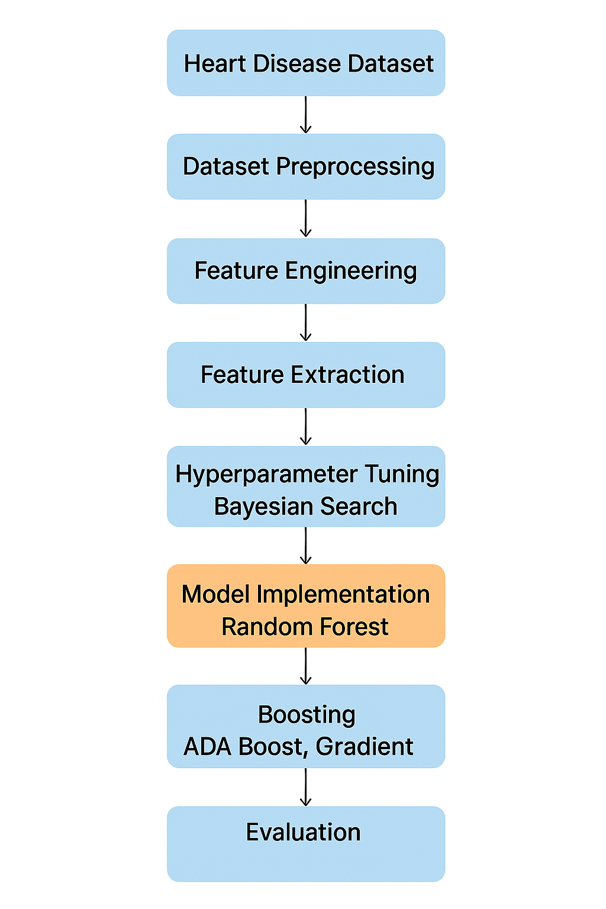
METHODOLOGY

Slide 6
Methodology
Dataset: UCI Heart Disease dataset.
Data Preprocessing: • Kept all medical records. • Missing values handled using regression, KNN imputation.
Feature Engineering: • Created 6 additional risk-related features (e.g., cholesterol risk flag, fitness index).
Model Development: • Random Forest (baseline). • Hyperparameter tuning with Bayesian search. • Ensemble learning: AdaBoost, Gradient Boosting.
Explainable AI: • Applied SHAP for interpretability.

Slide 7
Machine Learning
Exploratory Data Analysis.
Data Preprocessing.
Hyper parameter Tuning.
Cross Validation.
Model Implementation.
Ensemble Learning.
Model Deployment.

Slide 8
Explainable AI
SHAP used to interpret feature contributions.
Findings: • Chest pain consistently most influential feature. • Major vessels, resting blood pressure significant in AdaBoost.
Benefits: • Transparency in model decisions. • Improves clinical trust. • Supports further research by identifying key variables.

Slide 9
Results
Random Forest: F1: 76%, Recall: 90% for healthy class. Poor at detecting severe disease classes.
AdaBoost: Balanced but weaker PR AUC (0.565).
Gradient Boosting: Best performing model. F1: 80%, Recall: 88% for healthy class 0. Better detection of moderate disease cases (Class 1,2).
Key Features: Chest pain severity = most influential predictor. Major vessels, cholesterol, resting BP also important.

Slide 10
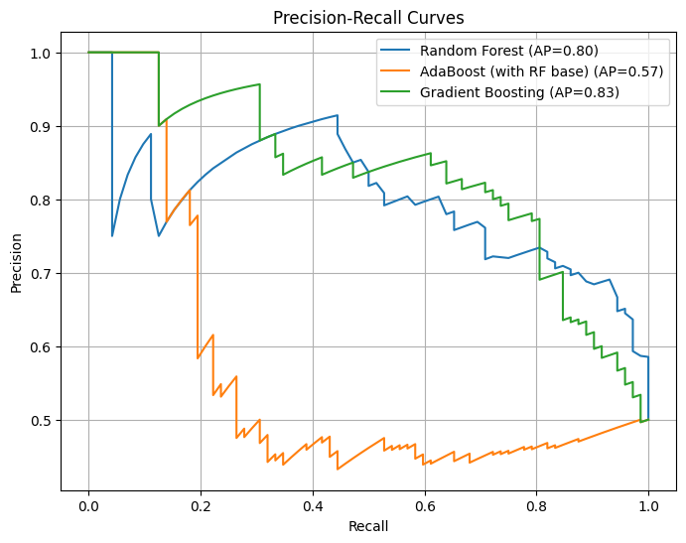
Precision-Recall Curves

Slide 11
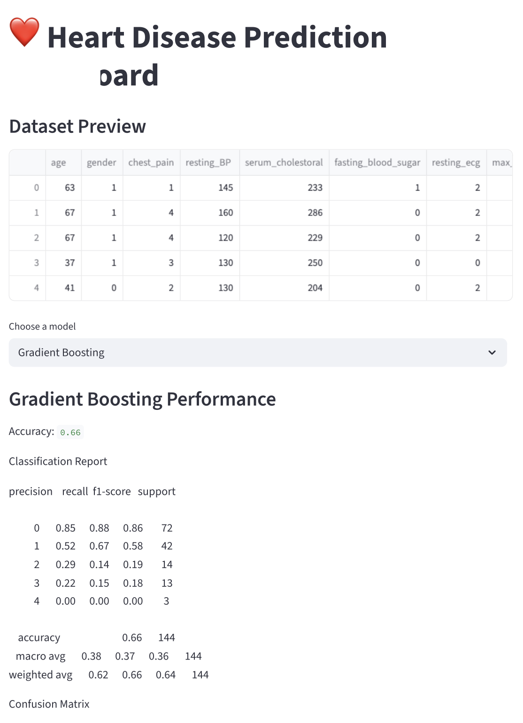
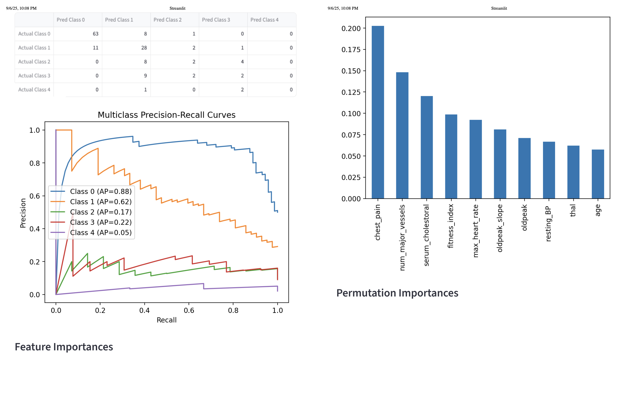
Model Deployment – Gradient Descent

Slide 12
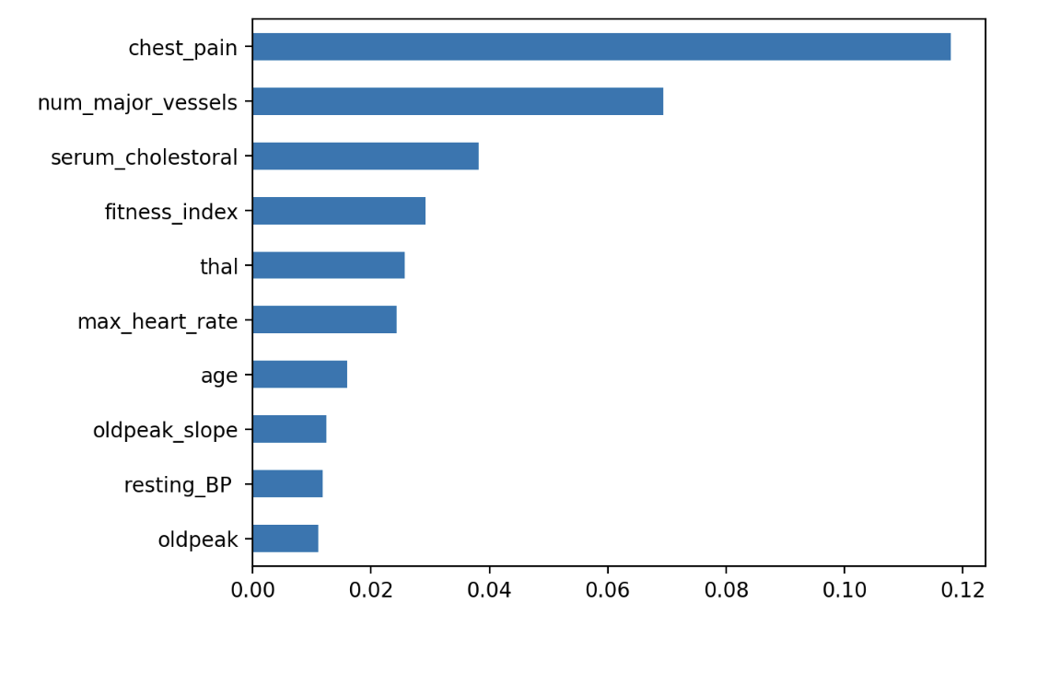
Gradient Descent – Feature Importance

Slide 13
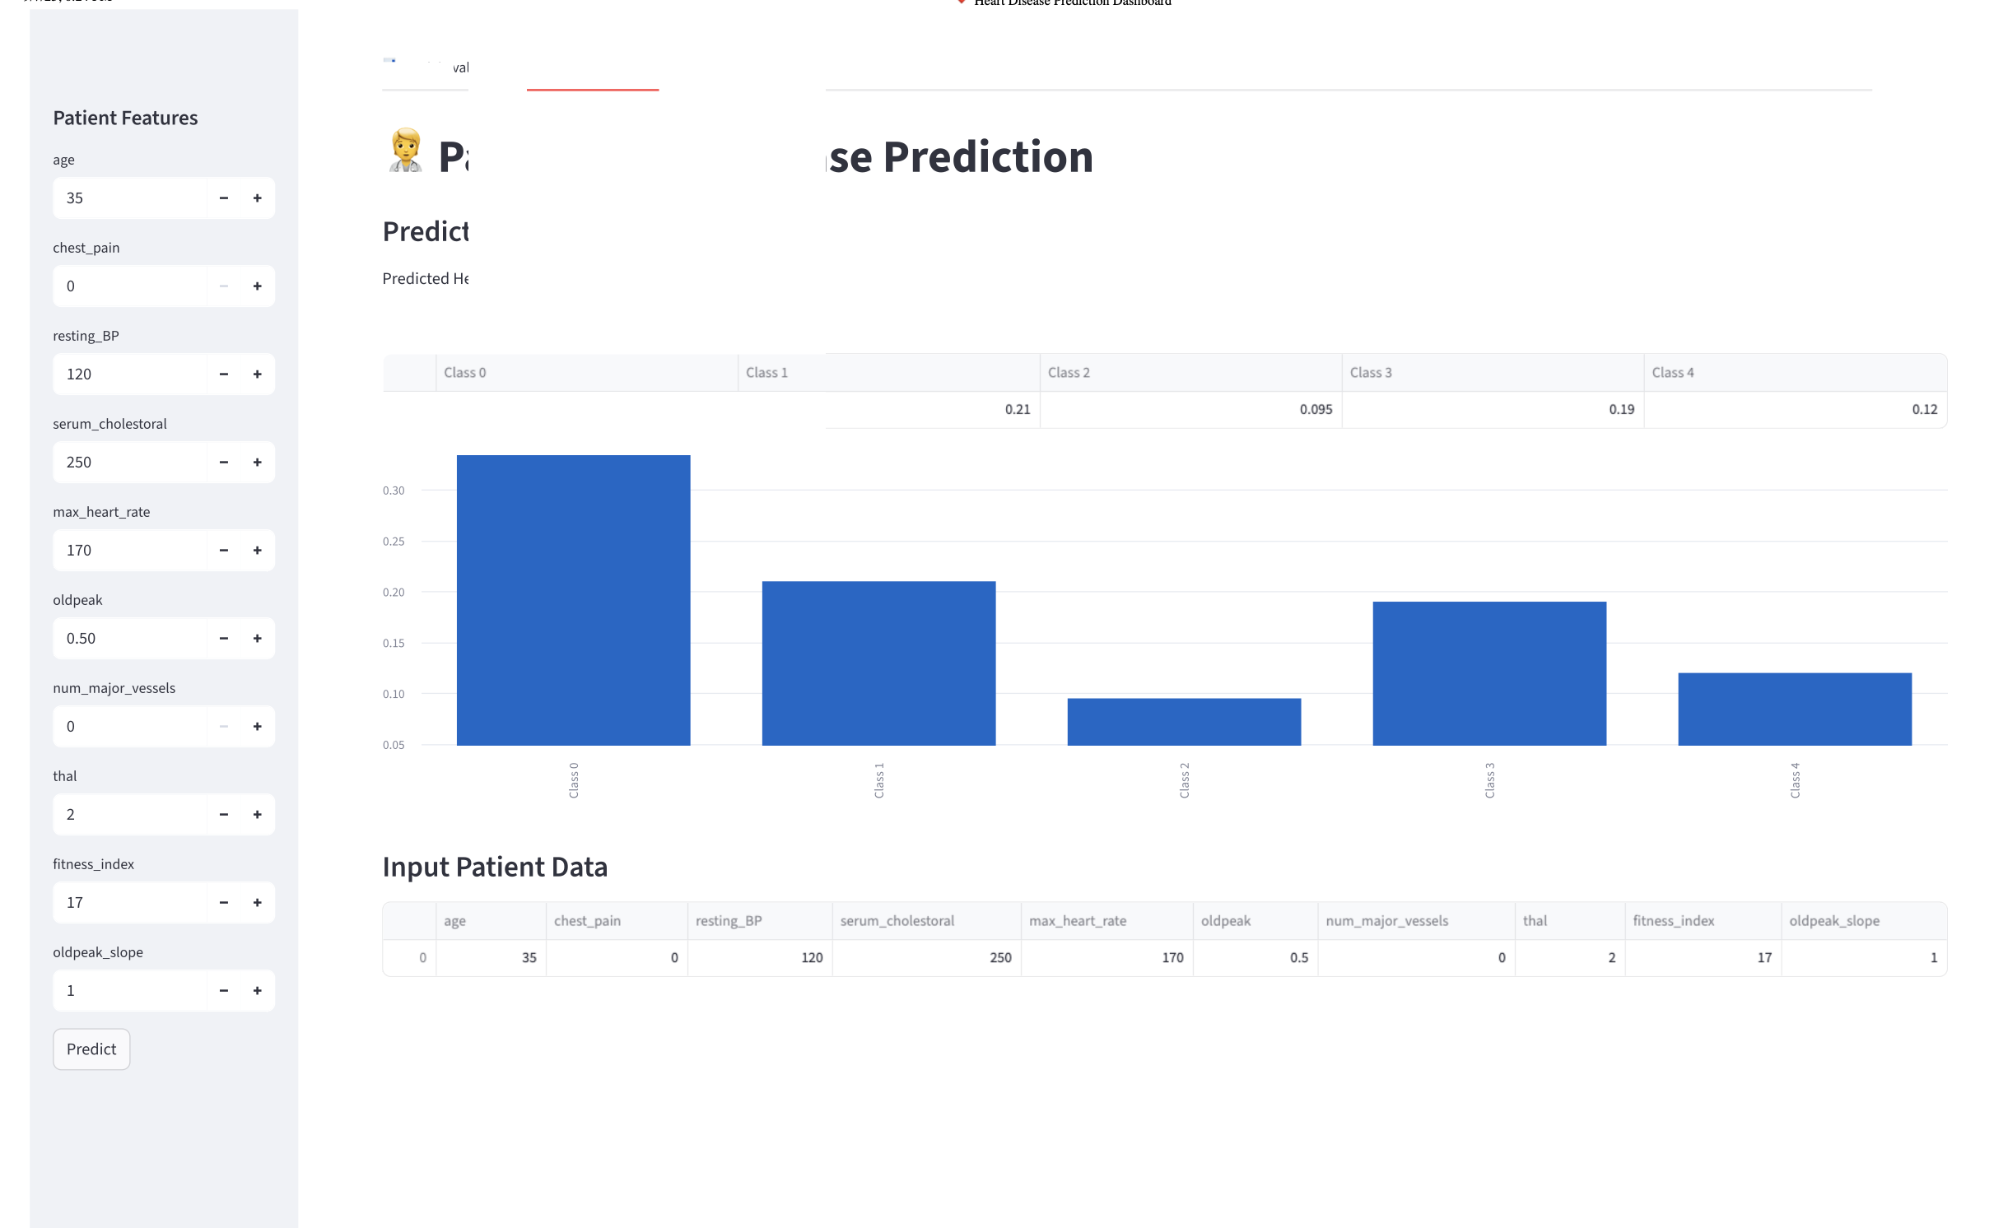
Gradient Descent – Prediction (Class 0)

Slide 14
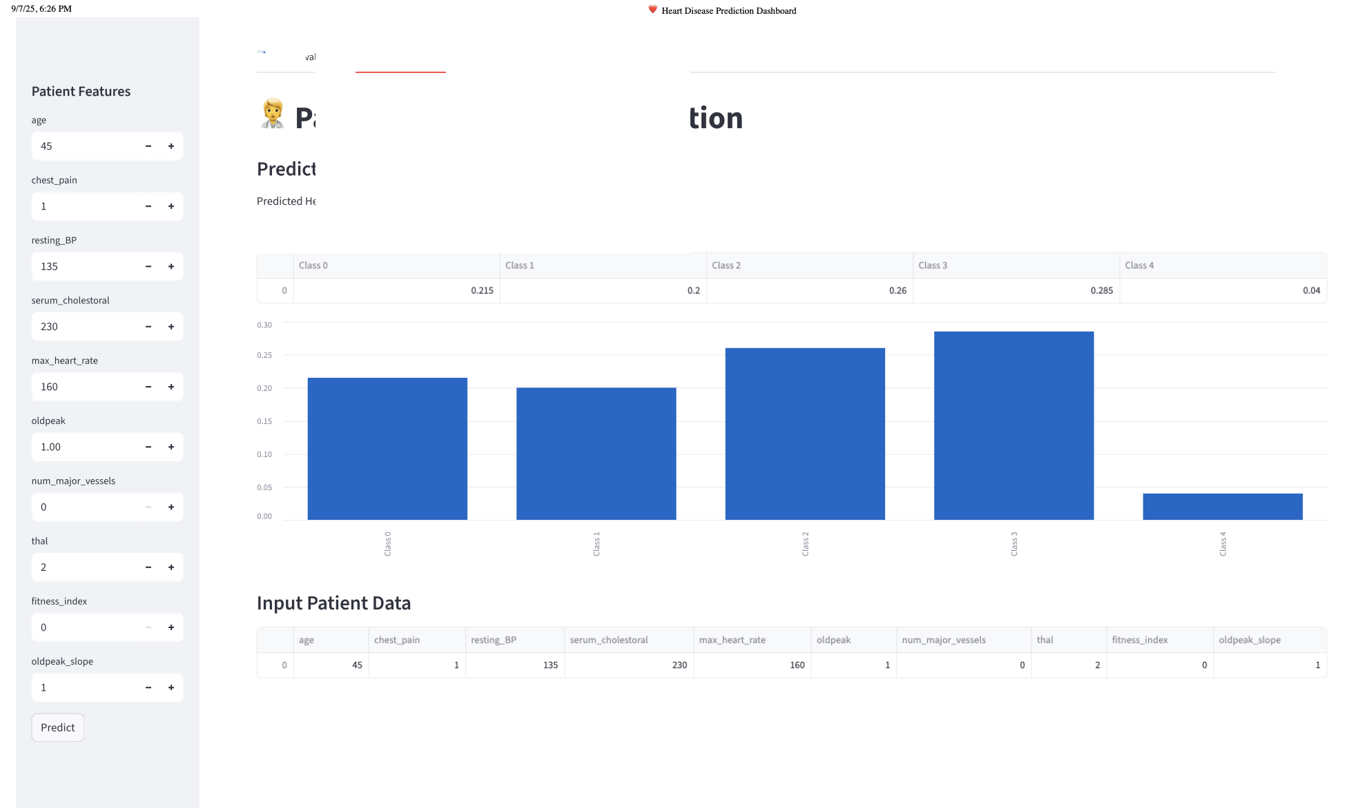
Gradient Descent – Predictions (class 3)

Slide 15
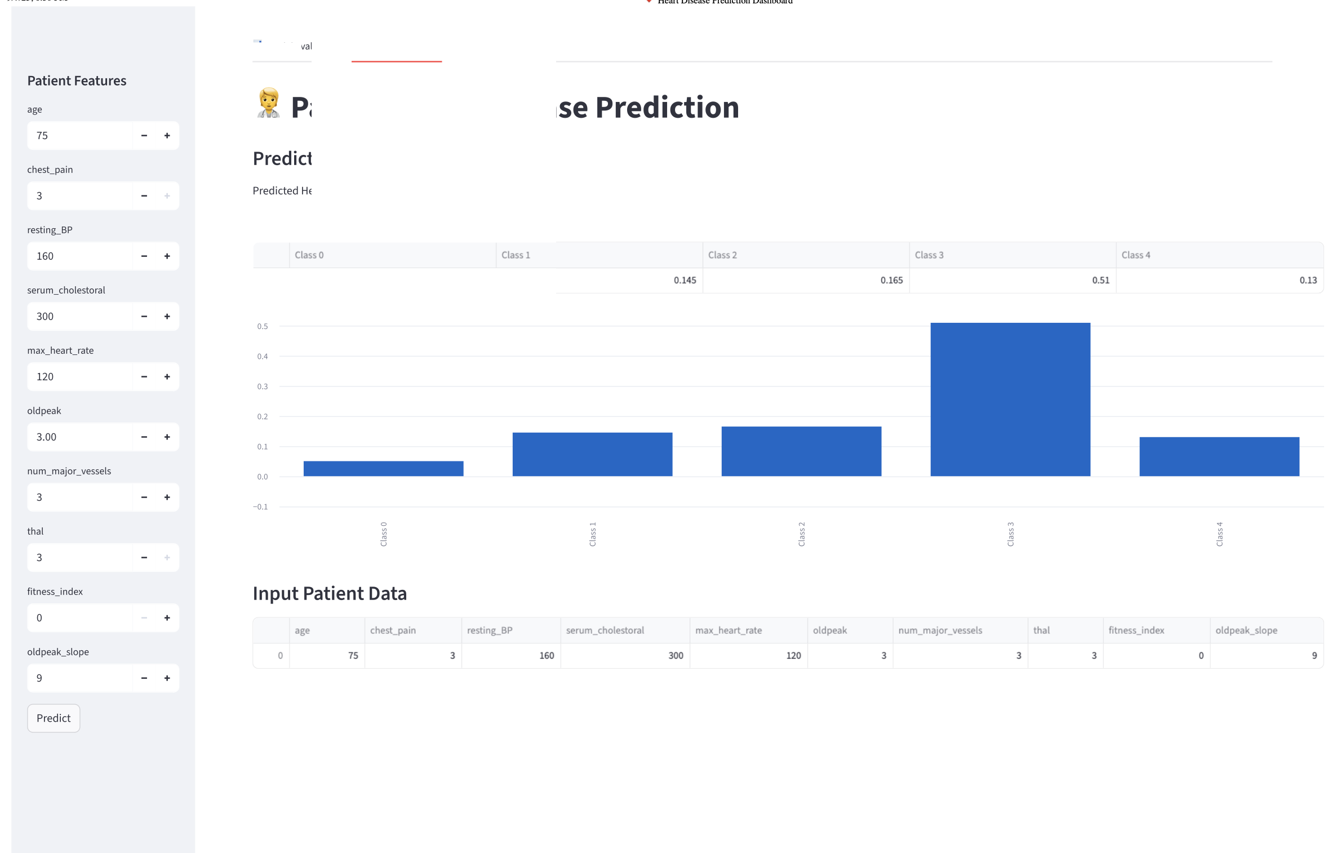
Gradient Descent – Predictions (class 4)

Slide 16
Conclusion & Future Work
Conclusions: • ML models can support early CVD detection. • Gradient Boosting outperformed other models (F1: 80%). • Integration of XAI provided transparency and trust.
Future Work: • Enhance severity classification (mild, moderate, severe). • Incorporate real-time clinical datasets. • Refine feature engineering for better interpretability.

Slide 17
References
Sethi, A., Dharmavaram, S. & Somasundaram, S. Explainable artificial intelligence (xai) approach to heart disease prediction in 2024 3rd International Conference on Artificial Intelligence For Internet of Things (AIIoT) (2024), 1–6.
Rezk, N. G., Alshathri, S., Sayed, A., El-Din Hemdan, E. & El-Behery, H. XAI-Augmented Voting Ensemble Models for Heart Disease Prediction: A SHAP and LIME-Based Approach. Bioengineering 11, 1016 (2024).
Aggarwal, R., Podder, P. & Khamparia, A. in Biomedical data analysis and processing using explainable (XAI) and responsive artificial intelligence (RAI) 91–103 (Springer, 2022).
World Health Organization. Cardiovascular Diseases https://www.afro.who.int/healthtopics/cardiovascular-diseases (2025).
Absar, N. et al. The efficacy of machine-learning-supported smart system for heart disease prediction in Healthcare 10 (2022), 1137.

Slide 18
References
Ahmad, B., Chen, J. & Chen, H. Feature selection strategies for optimized heart disease diagnosis using ML and DL models. arXiv preprint arXiv:2503.16577 (2025).
Mehta, H. & Passi, K. Social media hate speech detection using explainable artificial intelligence (XAI). Algorithms 15, 291 (2022).
Lee, H. & Tsoi, P. Feature-Enhanced Machine Learning for All-Cause Mortality Prediction in Healthcare Data. arXiv preprint arXiv:2503.21241 (2025).
Qadri, A. M., Raza, A., Munir, K. & Almutairi, M. S. Effective feature engineering technique for heart disease prediction with machine learning. IEEE Access 11, 56214–56224 (2023).
Guleria, P., Naga Srinivasu, P., Ahmed, S., Almusallam, N. & Alarfaj, F. K. XAI framework for cardiovascular disease prediction using classification techniques.
Electronics 11, 4086 (2022).
Mhamdi, L., Dammak, O., Cottin, F. & Dhaou, I. B. Artificial intelligence for cardiac diseases diagnosis and prediction using ECG images on embedded systems. Biomedicines 10, 2013 (2022).

Slide 19
References
Alom, Z., Azim, M. A., Aung, Z., Khushi, M., Car, J. & Moni, M. A. Early stage detection of heart failure using machine learning techniques in Proceedings of the International Conference on Big Data, IoT, and Machine Learning: BIM 2021 (2021), 75–88.
Gupta, S. K., Shrivastava, A., Upadhyay, S. P. & Chaurasia, P. K. A machine learning approach for heart attack prediction. International Journal of Engineering and Advanced Technology (IJEAT) 10, 1–11 (2021).
Gupta, C., Saha, A., Reddy, N. S. & Acharya, U. D. Cardiac Disease Prediction using Supervised Machine Learning Techniques. in Journal of physics: conference series 2161 (2022), 012013.
Ward, A. et al. Machine learning and atherosclerotic cardiovascular disease risk prediction in a multi-ethnic population. NPJ digital medicine 3, 125 (2020).
SHAP Documentation. An introduction to explainable AI with Shapley values https : / / shap . readthedocs . io / en / latest / example _ notebooks /overviews/An%20introduction%20to%20explainable%20AI%20with%20Shapley%20values.html (2025).

Slide 20
References
Rajendran, R. & Karthi, A. Heart disease prediction using entropy based feature engineering and ensembling of machine learning classifiers. Expert Systems with Applications 207, 117882 (2022).
Chandrasekhar, N. & Peddakrishna, S. Enhancing heart disease prediction accuracy through machine learning techniques and optimization. Processes 11, 1210 (2023).
Shrestha, D. Advanced Machine Learning Techniques for Predicting Heart Disease: A Comparative Analysis Using the Cleveland Heart Disease Dataset. Applied Medical Informatics 46 (2024).
Sharma, V., Yadav, S. & Gupta, M. Heart disease prediction using machine learning techniques in 2020 2nd international conference on advances in com- puting, communication control and networking (ICACCCN) (2020), 177–181.
El-Sofany, H., Bouallegue, B. & El-Latif, Y. M. A. A proposed technique for predicting heart disease using machine learning algorithms and an explainable AI method. Scientific reports 14, 23277 (2024).

